Slide 1
Community for Data Integration (CDI) FY17 Request for Proposals Process
Leslie Hsu, CDI Coordinator
September 29, 2016
4:00-5:00 ET

Slide 2
Topics
Summary of changes since last year (p.3)
Overview of the Community for Data Integration (CDI) (p.4)
Background of the CDI RFP Process (p.7)
Overview of the FY17 RFP (p.9)
Examples of successful projects (p.20)
Overview of online RFP Manager (p.24)
Key Dates (p.31)
Questions (p.32)

Slide 3
Changes since last year
Cover page now generated on RFP Manager (p.27)
No SOI related media
Collaboration Forum to find partners (p.29)
Closing session will be during the November Monthly Meeting (p.31)
CDI-sponsored event will be the FY17 Annual Workshop (p.29)

Slide 4

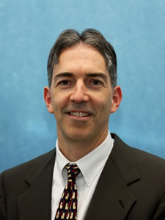
CDI - Overview
Chartered as Council on Data Integration in 2009 to:
Lead development of Data Integration Strategy
Recommend data integration guidelines
Promote USGS-wide data integration
Evolved into an open Community of Practice
Executive Sponsors:
Tim Quinn (left) and Kevin Gallagher (right)
Communities of practice are groups of people who share a concern or a passion for something they do and learn how to do it better as they interact regularly – Etienne Wenger, 2011

Slide 5
The CDI Purpose
Advance understanding of Earth systems through enhanced use of data and information
Provide a forum for sharing ideas and learning new skills
Increase the visibility of work with data and information

Slide 6
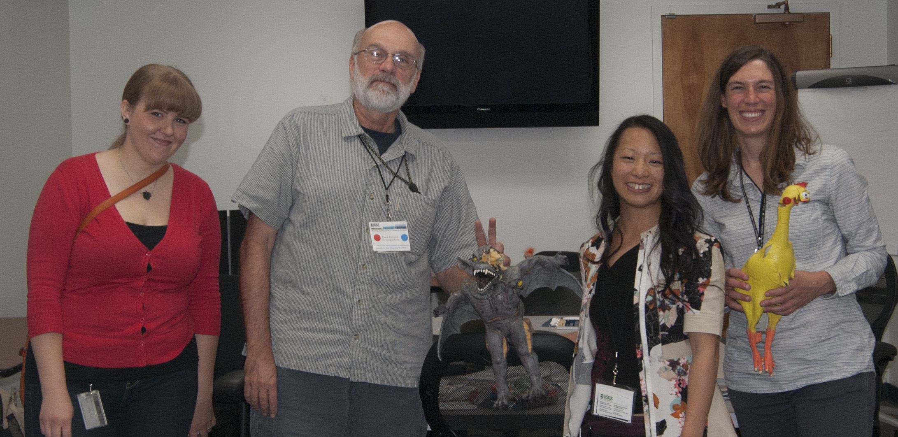
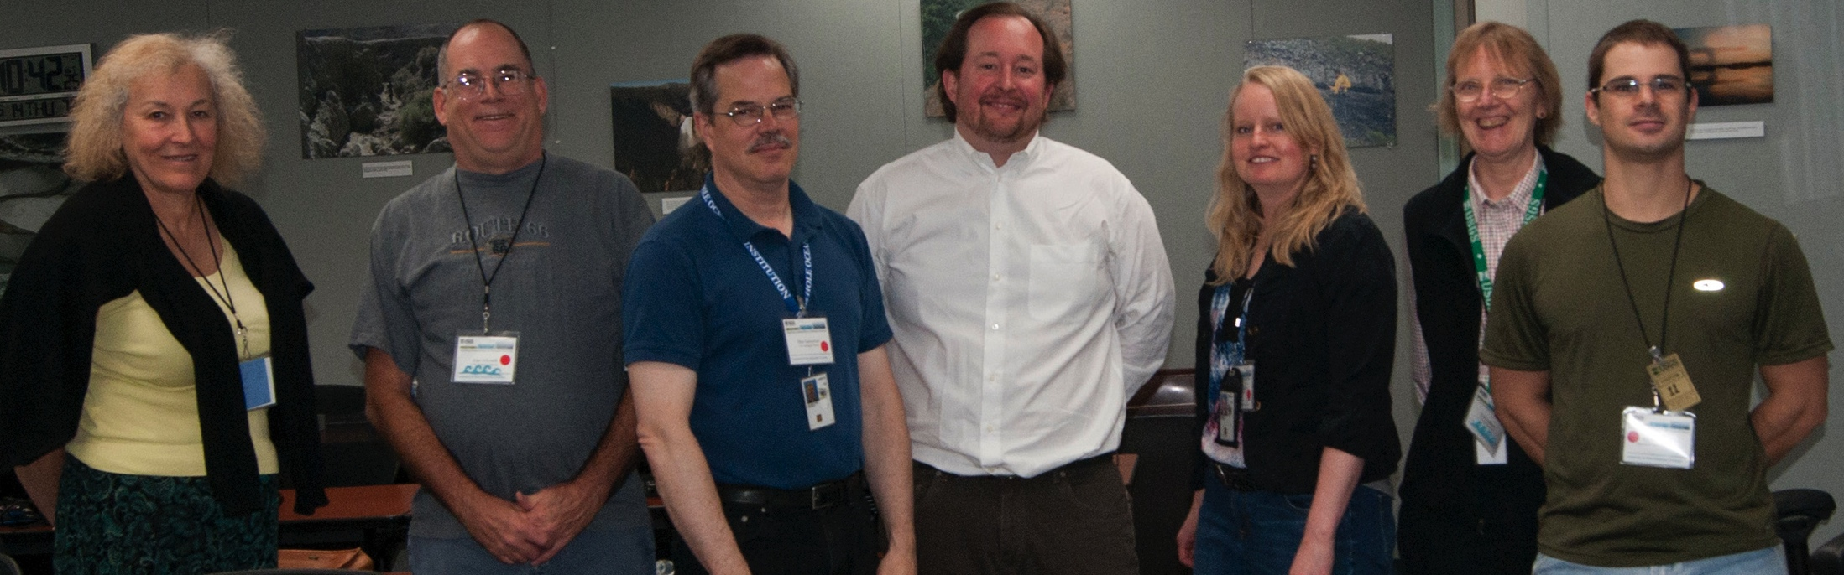
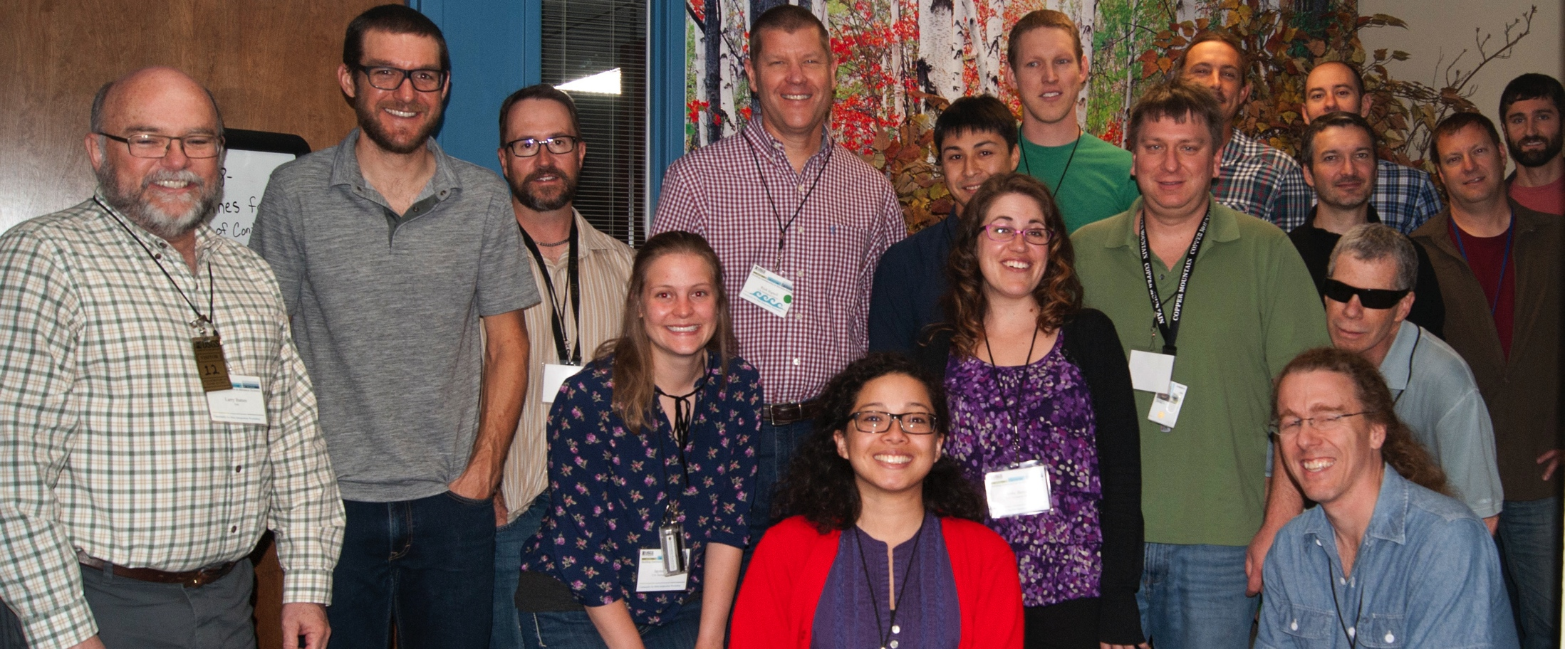
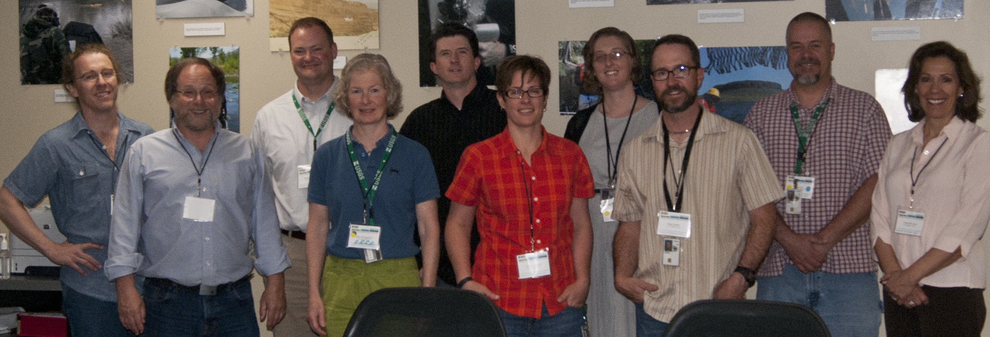
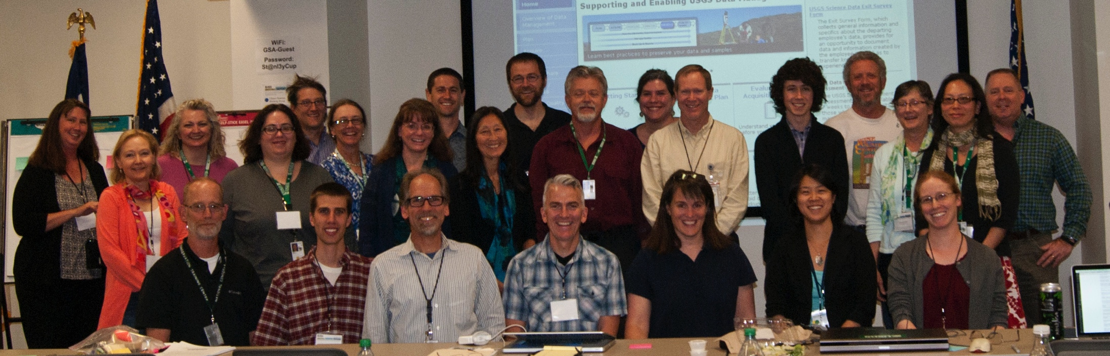
CDI Today
Monthly Forum
2nd Wed at 11 ET
Working Groups and Focus Groups
Citizen Science
Communication
Connected Devices
Data Management
Earth-Science Themes
Semantic Web
Technology Stack
Annual Workshop/Webinar
RFP Process

Slide 7
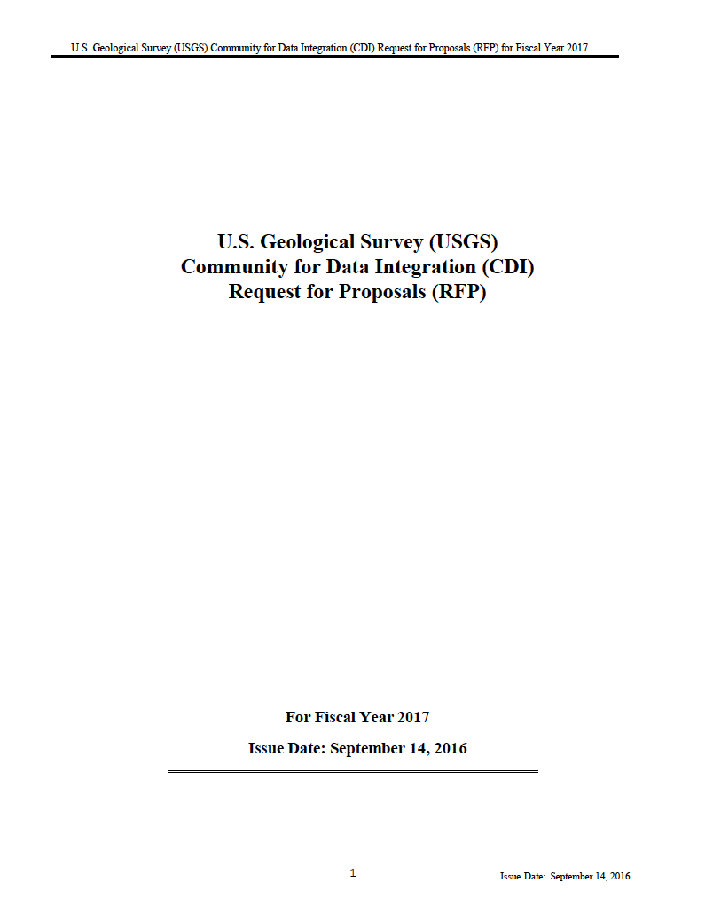
FY17 CDI RFP
http://www.usgs.gov/cdi/participate.html#rfp

Slide 8
2 Phase RFP
Phase 1) Statement of Interest
2 page max
Relate to Science Support Framework, Guiding Principles, and Evaluation Criteria
Voting by CDI Community Members
~20 top ranked SOIs invited to submit full proposal
Phase 2) Invited Full Proposal
Proposal narrative - 7 page max
Not including general public summary, detailed budget, data management planning form, letters of support, CVs
Relate to Science Support Framework, Guiding Principles, and Evaluation Criteria
Evaluated by formal Review Panel
Recommendations presented to CDI Executive Sponsors for selection and award

Slide 9
Details of the FY17 RFP
Eligibility: USGS employee must be PI, but collaboration is encouraged
Projects complete in 3-6 months
Mid Project and End of Project Reporting
Required to include travel $ for 2017 CDI-sponsored event.
All results should be publicly available (www.usgs.gov/cdi)
Including software products

Slide 10
Code Repositories
Example: Bitbucket Community for Data Integration Project
PI’s will be given permission to create repositories within this project
Repository admins assign permissions for their group
Repositories should be public after the completion of the project.

Slide 11
Funding
Max request = $50K
CDI funds can be used for salary, travel other expenses
CDI funds CANNOT be used for field work or Core Science System Mission Area federal employees salary
Proposal must have 30% matching funds from salary, travel, other grants, etc.

Slide 12
Factors of the FY17 RFP
Science Support Framework (SSF)
Applicants select top 3 SSF elements. http://www.usgs.gov/cdi/cdi-ssf/cdi-ssf-components.pdf
Guiding Principles
Evaluation Criteria
Notes:
I mentioned earlier that projects must relate to three aspects of the RFP:
Science Support Framework (SSF)
Applicants select top 3 SSF elements. No categories this year
http://www.usgs.gov/cdi/cdi-ssf/cdi-ssf-components.pdf
Guiding Principles
Evaluation Criteria

Slide 13
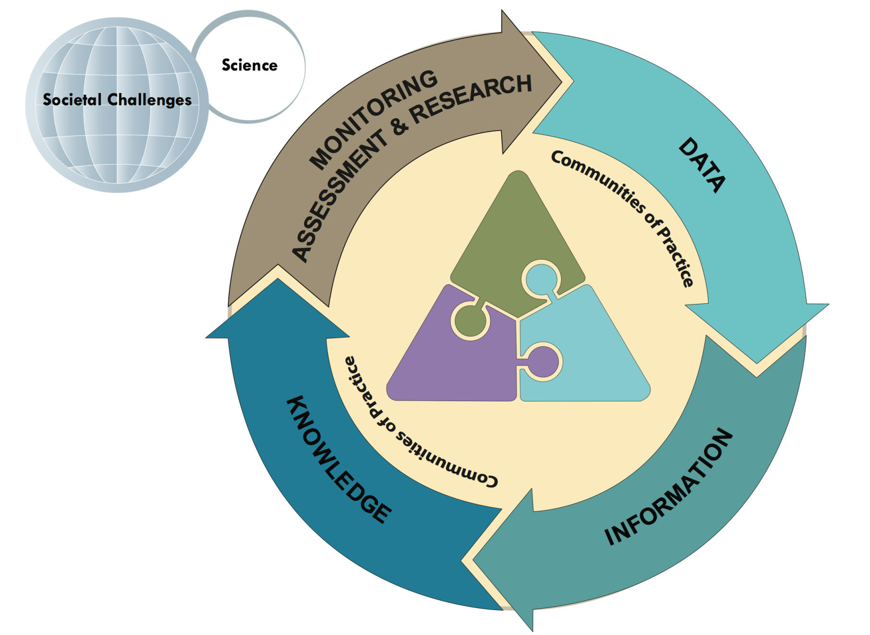



Big Picture
Computational
Tools & Services
Management,
Policy &
Standards
Data &
Information
Assets

Slide 14

Upper Level Categories
 | Data Persistent archives, data registries, catalogs, data, metadata, derived information products, knowledge bases, vocabularies/ontologies.
 | Technology Applications, web services, data discovery tools, models, semantic services & tools, infrastructure, data brokers and visualization tools.
 | Business Data stewardship, implementation of the Data Management Life Cycle, knowledge management, data standards, governance and policy.
 | People Scientists, CDI as a whole, CDI Working Groups, external partners, and the human network of scientific domain collaborators.
Data &
Information
Assets
Computational
Tools & Services
Management,
Policy &
Standards
Communities
of Practice

Slide 15
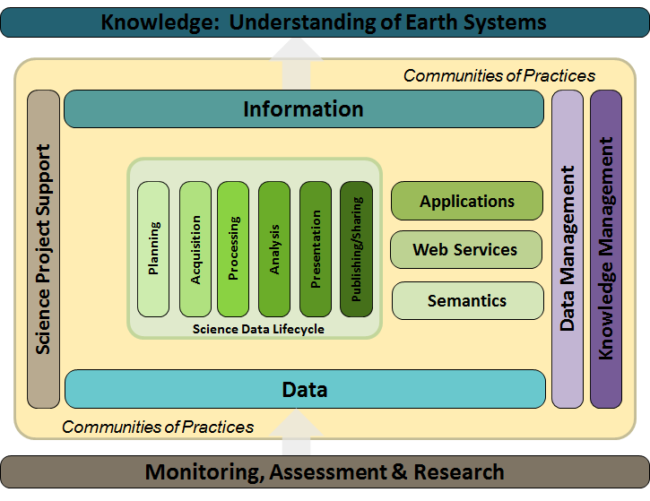
CDI Science Support Framework The foundation for sharing science

Slide 16
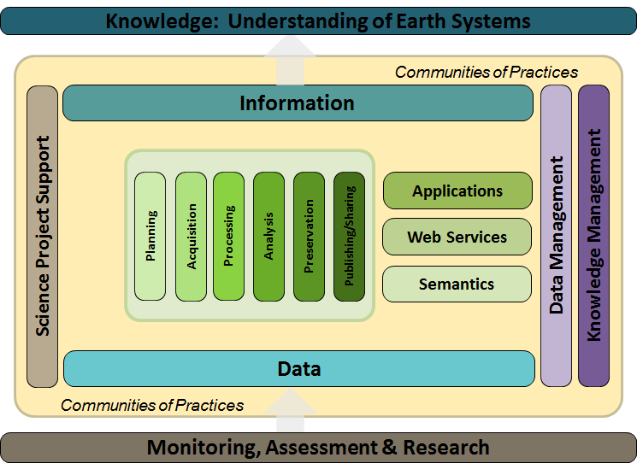
CDI Science Support Framework
Integration of Phenological Forecast Maps
Integrating the SDM Foundation process into current scientific workflow systems
Data Management Training Clearinghouse
Framework for Web portal development
2016 Data at Risk CDI Proposal
Publishing Digital Data for Dynamic Visualization
National Stream Characterization
Community vulnerability to hazards
Integration of National Soil and Wetland Datasets
Hunting Invasive Species with HTCondor
Crowd-sourced Earthquake Detections

Slide 17
Guiding Principles
Focus on targeted efforts that yield near-term benefits to Earth and biological science
Leverage existing capabilities and data
Implement and demonstrate innovative solutions (e.g. methodologies, tools, or integration concepts) that could be used or replicated by others at scales from project to enterprise
Preserve, expose, and improve access to Earth and biological science data, models, and other outputs
Develop, organize, and share knowledge and best practices in data integration

Slide 18
Evaluation Criteria
Scope
(25%)
Is there a demonstrated need for the effort/activity?
Technical Approach (25%)
Is the technical approach applied to the problem reasonable?
Project Experience and Collaboration (25%)
Does the project team have the appropriate experience, special qualifications, and skills for successful completion of the project.?
Is the approach innovative?
How much does the proposal contribute to the guiding principles and element(s) of the CDI Science Support Framework?
Is there potential impact beyond a single Program, Center, Mission Area, or Region?
What is the anticipated return on investment (e.g. cost savings, code utilization, publications, operational efficiencies, etc.)?
Does it employ a proven, reliable technique that is appropriate to the problem?
Have inter-disciplinary or cross-mission area/region collaboration and partnerships been pursued where appropriate?

Slide 19
Evaluation Criteria
Sustainability
(15%)
Does the proposal describe the intended sustainability of the project deliverables (products, tools, services, metadata) for long-term access, reusability, and potential for integration?
Budget Justification
(5%)
Is the budget at or below $50,000 and does it meet the minimum 30% in-kind match?
Timeline
(5%)
Are the project phases and milestones described in the technical approach?
Will all products resulting from the project be freely shared and made available, without charge or restriction, to the CDI, the broader USGS community, and beyond as appropriate?
Are salaries and contractor costs, travel, and equipment/ publication costs justified and appropriate to project needs?
If the proposal lists contractor support, does the proposal describe how the contract work will be managed and documented?
Is the proposed workload feasible given the project duration.

Slide 20
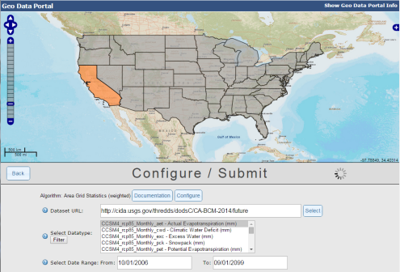
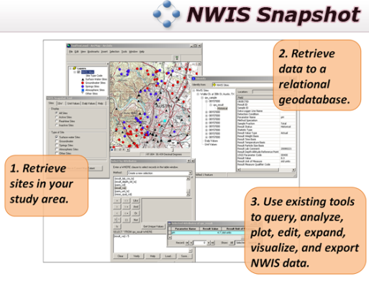
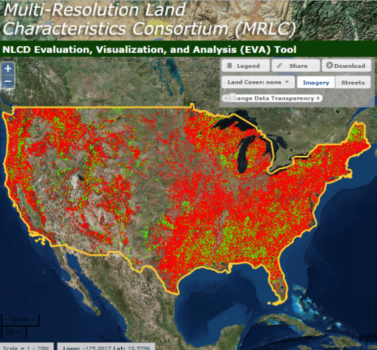
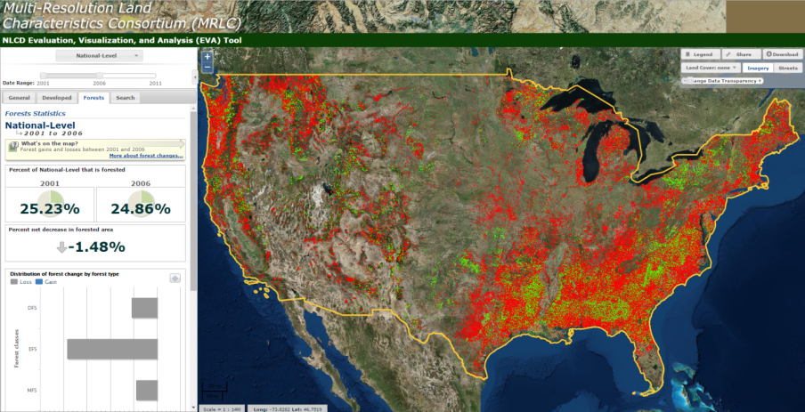
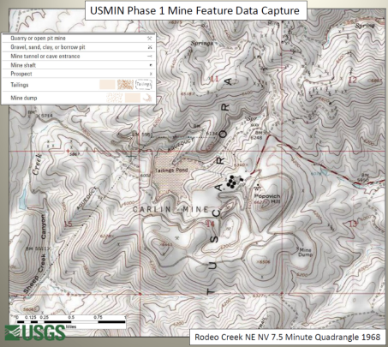
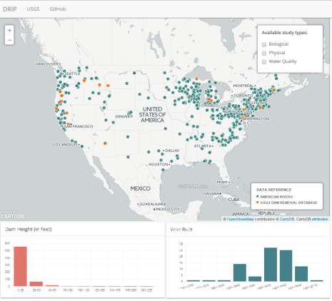
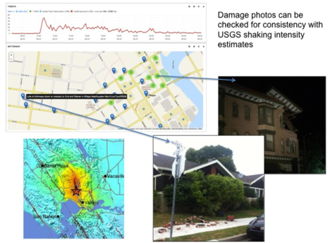
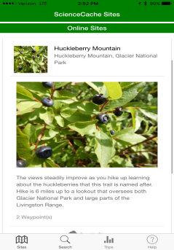
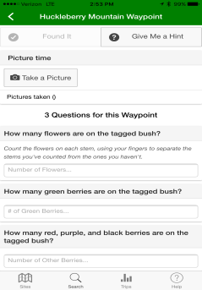
CDI Projects

Slide 21


CDI Projects

Slide 22
More information on past projects
Browse past projects to see what has been funded by CDI.
CDI Webpage (by topic or year)
ScienceBase CDI Community (by year)
Monthly Meeting presentations on many projects*
Annual Reports have project summaries*
*To access all of the materials, email cdi@usgs.gov to become a CDI member.

Slide 23
Proposal Concepts not CDI focused
Supporting the collection of new data or field research
Monitoring, assessment, or dataset creation projects. Although CDI may fund the creation of some broadly-usable (“foundational”) data content, this is normally considered out of scope
Projects that would normally be funded by individual Program Areas or other proposal processes such as the John Wesley Powell Center for Analysis and Synthesis, Center of Excellence for Geographic Information Science (CEGIS), Innovation Center for Earth Sciences (ICES), and Office of Organizational and Employee Development (OED).
Explanation of different funding opportunities. CDI October 12, 2016 Monthly meeting will expand on these distinctions.

Slide 24
RFP Manager Live Demo
Live demo!

Slide 25
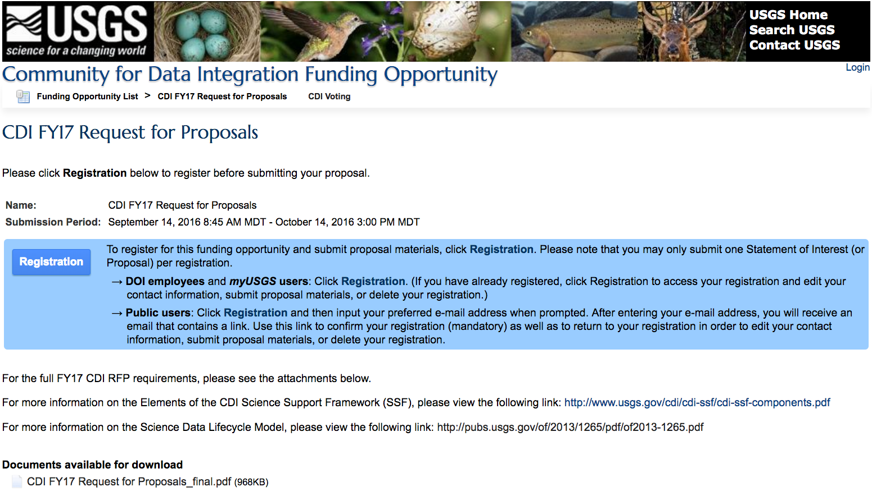
Proposal Submission: RFP Manager
https://my.usgs.gov/CDI_RFP

Slide 26
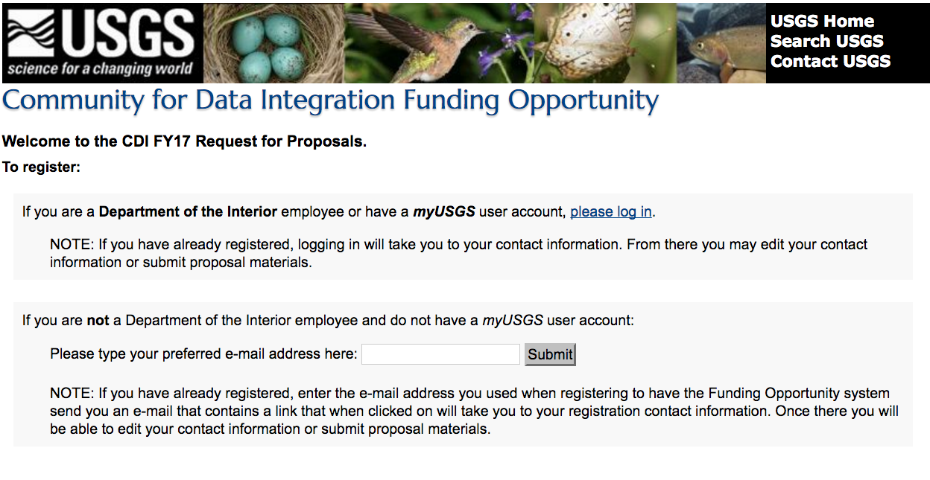
RFP Manager (cont.)

Slide 27
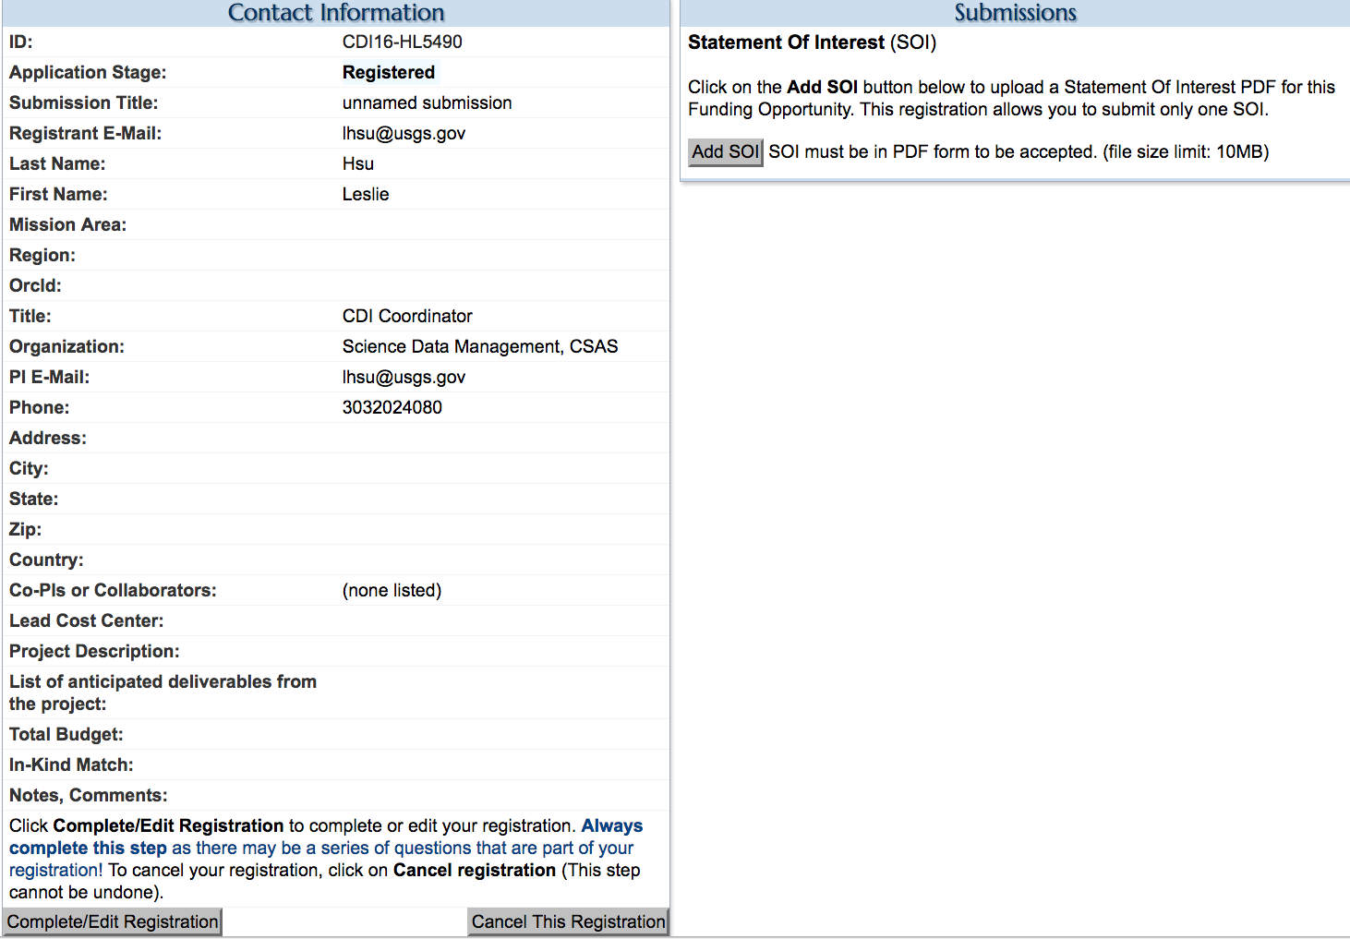

Slide 28
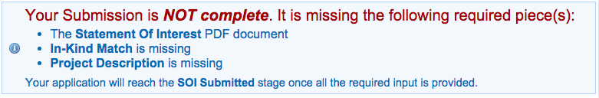
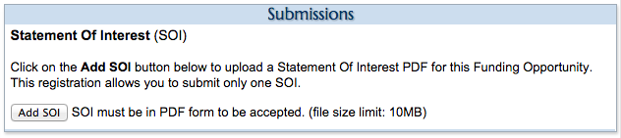
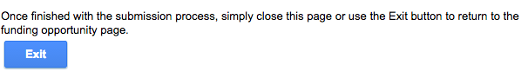

Slide 29
Tips and Observations
Communicate potential for partnerships and reusability – Use the Collaboration Forum
RFP Manager tips
Complete all fields, even if not required
Save/update often, compose text on external text editor
Budget – double check follow all guidelines
Travel to a CDI-sponsored event will be the Spring 2017 CDI Workshop most likely in Denver or Reston
Visit the FAQ page

Slide 30
SOI Voting Process
Community voting through UserVoice system
Must be a CDI Member (email: cdi@usgs.gov)
Read all SOIs before voting
Community can comment on SOIs – important for PIs to respond
SOI close of voting session – November 9
Top ~20 full proposals selected from all SOIs submitted. Based on variety of factors:
# of votes
# individual voters
Emerging priorities

Slide 31
Key Dates
October 14 @ 5 pm ET | Statements of Interest (SOI) Due
November 9 @ 11 am ET | SOI Voting – Closing Session
November 28 | Invite Full Proposal Submissions
Jan. 20, 2017 @ 5 pm ET | Full Proposals Due
Jan. – Feb. 2017 | Full Proposal Review Panel
March 8, 2017 | Awarded Projects Announced

Slide 32
Questions
Email: cdi@usgs.gov
Website: http://www.usgs.gov/cdi
RFP Announcement: http://www.usgs.gov/cdi/participate.html#rfp

